Slide 1
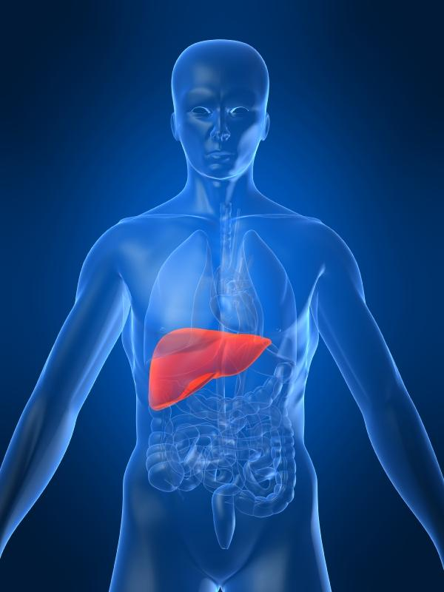
Metabolic Diseases Lesson 2.4
Glucose homeostasis in the blood – The Metabolism Game

Slide 2
Do Now
Why is homeostasis of glucose in the blood important?

Slide 3
Do Now
Why is homeostasis of glucose in the blood important?
Glucose is needed to transport energy from cell to cell.
The brain and red blood cells can’t use fatty acids or amino acids for energy.
ATP cannot be transported from cell to cell.

Slide 4
ATP cannot be transferred from cell to cell but GLUCOSE can!
How is glucose homeostasis maintained?

Slide 5
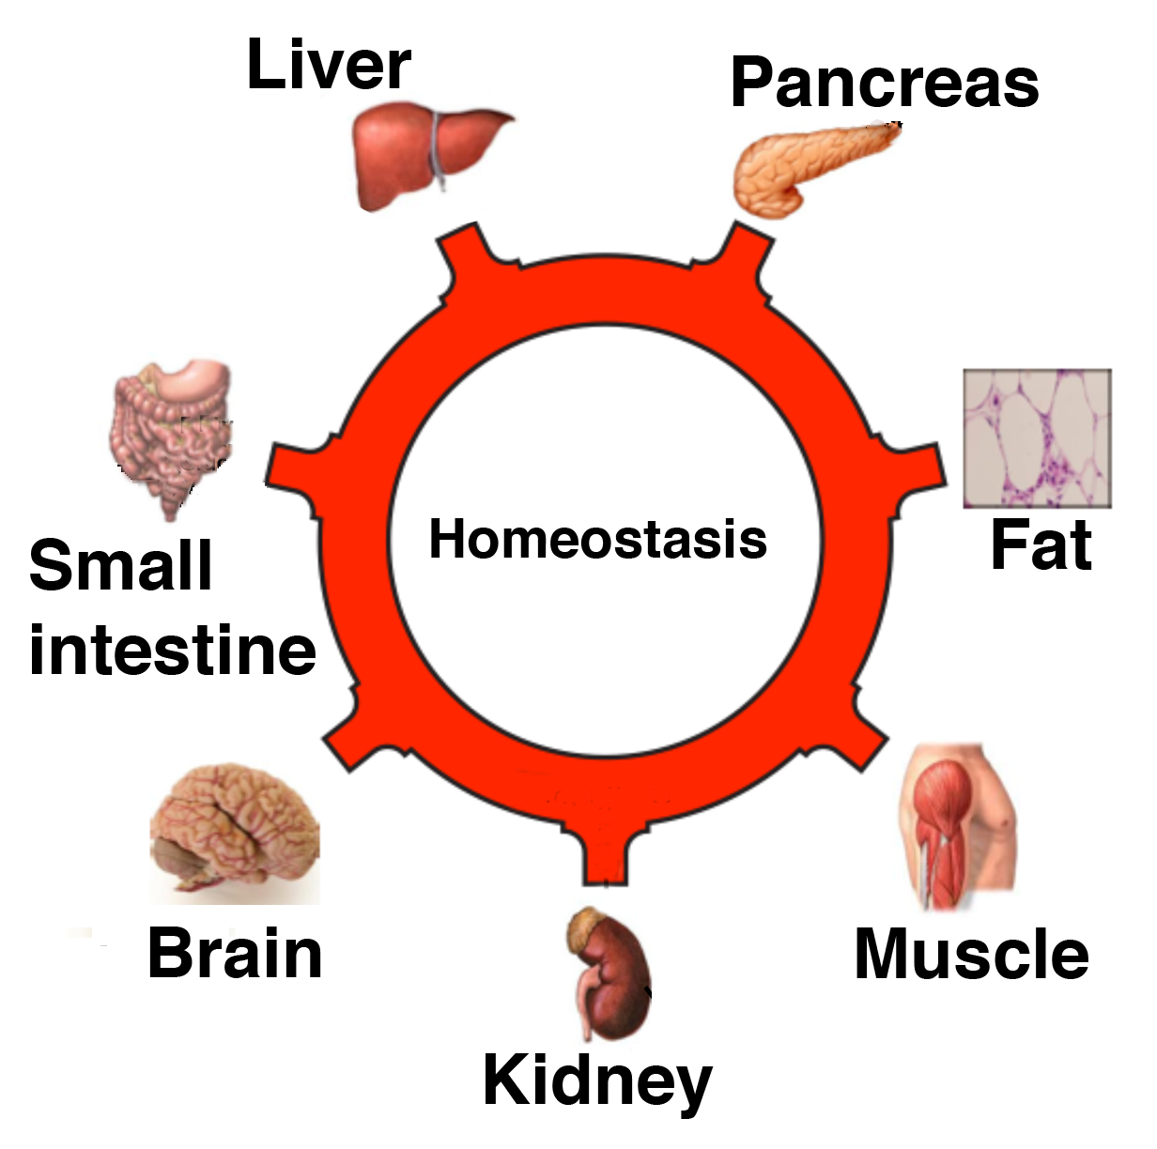
Organs involved in glucose homeostasis
Takes up nutrients and repackages them for storage
Sends glucose to blood when needed
Senses high or low blood glucose and sends out hormones
Digests and absorbs food
Stores extra energy as fat
Stores extra energy as glycogen and proteins
Needs glucose to function!
Clears waste from amino acid metabolism (deamination)

Slide 6
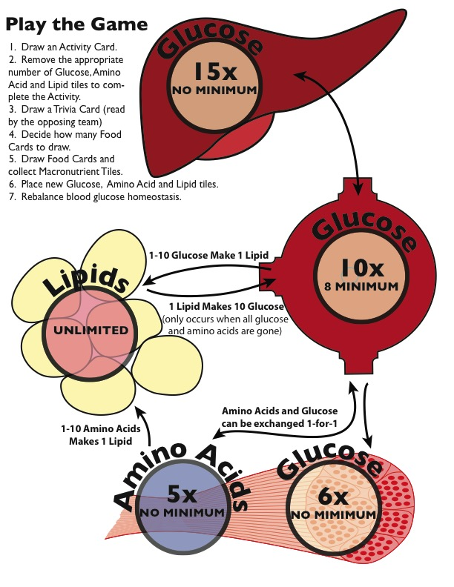
Activity: The Metabolism Game

Slide 7
Wrap Up: Too much glucose in the blood

Slide 8
Wrap Up: Too little glucose in the blood

Slide 9
Homework
Fill out the worksheet listing the processes in energy metabolism and storage

